Slide 1

about: OBS
Name
openSUSE Ambassador
name@opensuse.org

Slide 2
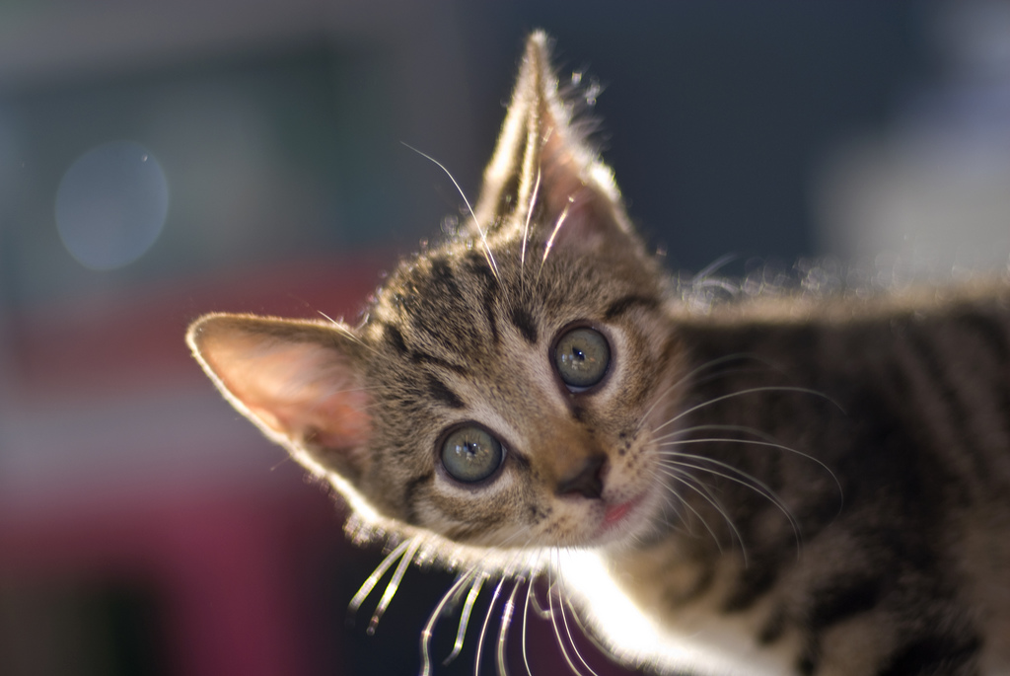
Me

Slide 3
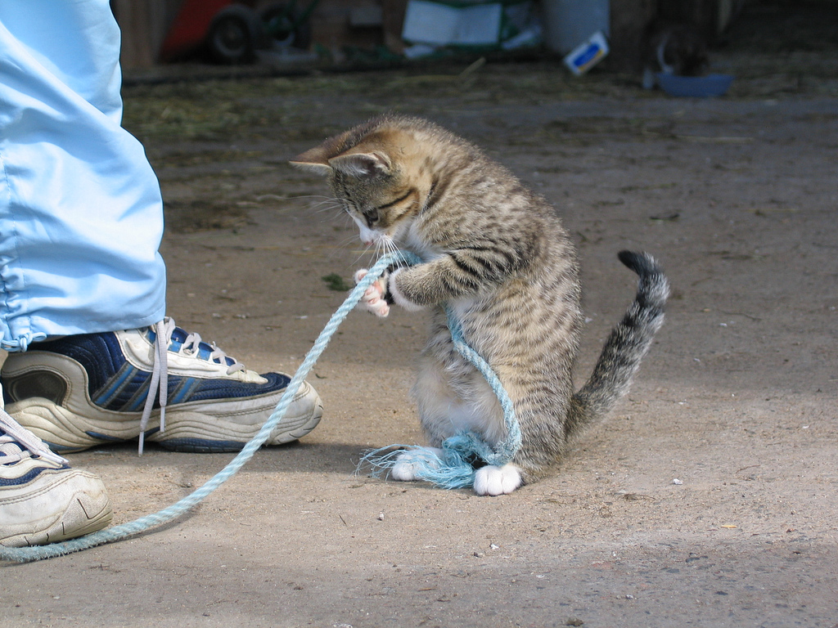
Hard Work

Slide 4

OBS
Free
on
build.opensuse.org
200.000
users
packages
40.000
26
7
distributions
architectures

Slide 5
OBS
RPM
DEB
TGZ
EXE
Virtual Machine
Web interface

Slide 6
OBS
Collaboration
Tizen
Nokia
VLC
Intel
Linux Foundation
Cray
OCS
DELL

Slide 7
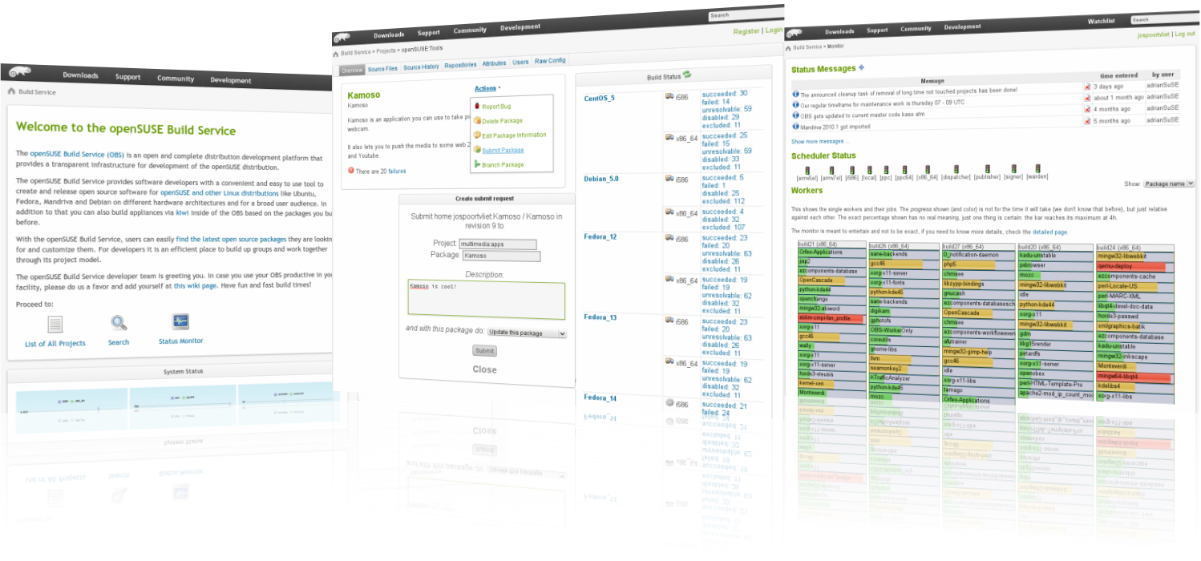
build.opensuse.org

Slide 8

Newcomers welcome

Slide 9

opensuse.org
planet.opensuse.org
opensuse.org/Portal:How_to_participate
opensuse.org/Junior_jobs
features.opensuse.org
build.opensuse.org
#opensuse-project

Slide 10

Join the gang

Slide 12
Kitty Image Credits
Me: Merlijn Hoek
Hard at work: anzaq78
Newcomers: abcrumly
Join the gang: malingering
To be found on Flickr under the above names with a Creative Commons license. Thanks all!

Slide 13
Have a lot of fun!
Notes:
Thanks for listening!

